Slide 1




DCBD presentation
Presented by: NSSA
14/04/2024
Blockchain

Slide 2
Team Members
Nandini
Sreeja
Satyaki
Aritra

Slide 3
CONTENTS
01: Demystifying Blockchain
02: Working and Applications
03. Benefits and Drawbacks
04. Conclusion

Slide 4
PART 01
Demystifying Blockchain

Slide 5
History and Evolution
1991
2008
First proposed by Stuart Haber and Scott Stornetta as a way to timestamp documents.
Bitcoin introduced blockchain as a secure way to record cryptocurrency transactions.
Satoshi Nakamoto’s revolutionary Bitcoin paper
2014
Present
Blockchain is being adopted across various industries, transforming business models and processes.
Ethereum platform launched, enabling smart contracts and decentralized applications.

Slide 6
Why Blockchain?
To eliminate the need for a central authority to control and manage transactions, thereby reducing the risk of censorship, manipulation, and fraud.
To create a tamper proof and auditable record of transactions that cannot be altered or deleted, providing increased transparency and accountability.
To utilize cryptography and distributed ledger technology to enhance the security of transactions and protect them from unauthorized access or manipulation.
To streamline and automate processes, reducing the time, cost, and complexity associated with traditional transaction methods and intermediaries.
Decentralization
Immutability
Security
Efficiency

Slide 7
What’s Blockchain?
Distributed
Transparent
A distributed ledger technology.
All participants can see the ledger.
Decentralised
Immutable
No single authority controls it.
Records cannot be altered.

Slide 8
PART 02
Working and Applications

Slide 9
How Blockchain Works
Transactions
Miners
The Lifeblood of the System
The Blockchain Guardians
Transactions represent the core interactions within a blockchain network. They signify exchanges of value or information between participants.
Miners play a crucial role in securing the network and adding new blocks to the chain. They act as the distributed ledger's bookkeepers
Nodes
Blocks
The Distributed Network Powerhouse
Bundling Transactions for Security
Nodes are the individual computers or devices participating in the blockchain network. They contribute to the network's decentralization and security.
Individual transactions wouldn't be very secure floating around on their own. That's where blocks come in. Blocks act as secure containers, bundling a group of verified transactions together

Slide 10
Components
Blocks
Contains data about transaction and other records.
Linked together in chronological order.
Hash
Unique identifier for each block.
Generated using a cryptographic algorithm.
Previous Hash
Link to hash of previous block
Creates an immutable chain of blocks.

Slide 11
Consensus
Proof of work
Proof of Stake
Delegated Proof of Stake
Nodes solve complex mathematical puzzles to validate transactions, receives rewards upon completion
Nodes stake their cryptocurrency holdings to validate transactions. The more cryptocurrency a node stakes, the higher its chances of being selected to add a block to the chain
Nodes elect a set of delegates to validate transactions on their behalf. Delegates receive a portion of the block rewards.

Slide 12
Transactions
Nodes verify the transactions:
Transactions are added to a block
Check if the sender has sufficient funds.
Verify the sender's signature.
Nodes create new blocks containing verified transactions.
Block is hashed and added to the chain:
Consensus ensures agreement:
The block's hash is calculated, linking it to previous blocks.
The new block is added to the immutable blockchain.
Majority of nodes agree on the validity of the transactions.
Once added, can’t be altered.

Slide 13
Crypto in Blockchain
Digital Signatures
Cryptography
Hashing
Blockchain uses hashing to create unique fingerprint for each block of data, ensuring integrity and immutability.
It uses public-key cryptography for secure communication and user privacy. Private keys decrypt-encrypt data while public keys verify transactions.
In blockchain digital signature cryptographic links transactions to specific users.

Slide 14
Applications
Finance
Healthcare
Supply chain mgmt
Cryptocurrency, digital-assets
Cross-border payments
Drug traceability, supply chain transparency
Improved tracking
Enhanced efficiency
Government Sector
Others
Voting System
Secure and transparent record keeping
Gaming and metaverse
Media and entertainment

Slide 15
PART 03
Benefits and Drawbacks

Slide 16
BENEFITS
Increased Transparency
Enhanced security
Tracking Food in a supply chain
Cryptography
Reduced Costs
Automation of processes
Cross-Border Payments
Royalties and Copyright Management

Slide 17
Drawbacks
Scalability
Energy
consumption
Regulation
Security
Complexity
They are inherently slow and can only process limited transactions.
Require Significant computational power and consumption of energy.
Complex to understand and implement.
Relatively new evolving field, regulatory landscape still developing.
Prone to hacking and other attacks.

Slide 18

Future Trends
BaaS
Integration with AI
Deploy blockchain applications without extensive technical expertise
Using AI to analyze vast amounts of data stored on blockchains
Rise of Metaverse
DeFi
Powering the metaverse by enabling secure digital ownership and identity
Financial services without intermediaries

Slide 19
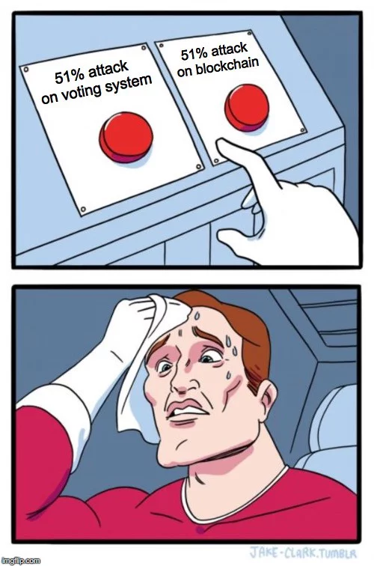
51% Attack
Crypto Under Siege
Panic Mode On
Imagine a powerful foe controlling half of a town's guards. That's the idea behind a 51% attack on a blockchain. In this digital world, miners are the guards, securing transactions. A 51% attack is when a malicious group grabs control of over half the mining power.
Block: Like stopping legitimate trades from going through.
Rewind: Potentially reversing their own purchases (double spending).
Disrupt: Causing chaos and undermining trust.
This attack happened on Bitcoin Gold
(2018) double-spending $18 million :x

Slide 20
PART 04
Conclusion

Slide 21

The Revolutionary Impacts
The advent of blockchain technology has not only disrupted various industries but also holds immense potential to transform our societies and economies in profound ways.
Disruption Dominoes
Its decentralized, immutable, and transparent nature provides a robust foundation for innovation, security, and efficiency gains.

Slide 22
Fortress of Data
IMMUTABLE
SECURE
Once data is immutably recorded on a blockchain, it cannot be altered or deleted
Strong cryptographic protocols protect the network from unauthorized access and fraud, making it highly secure.

Slide 23
Saving the Best for Last?
The growth of the blockchain ecosystem fosters collaboration and drives technological advancements.
Blockchains provide a fertile ground for innovation, enabling the creation of decentralized applications (dApps), smart contracts, and new business models.
Innovation
Blockchains have the potential to revolutionize industries such as finance, supply chain management, and healthcare.
They empower individuals, enhance transparency, and create new opportunities for economic growth and social impact.
Transformative Potential

Slide 24
Thanks For Watching
Presented by: NSSA
14/04/2024
Blockchain

